Slide 1
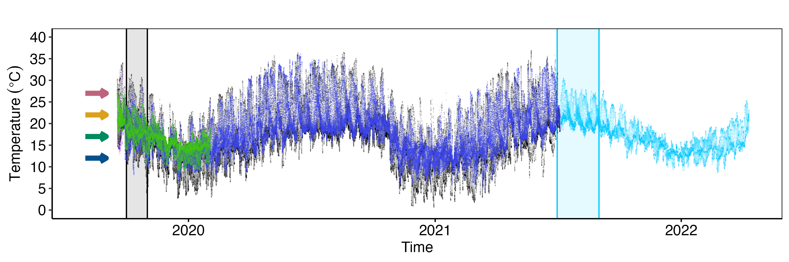
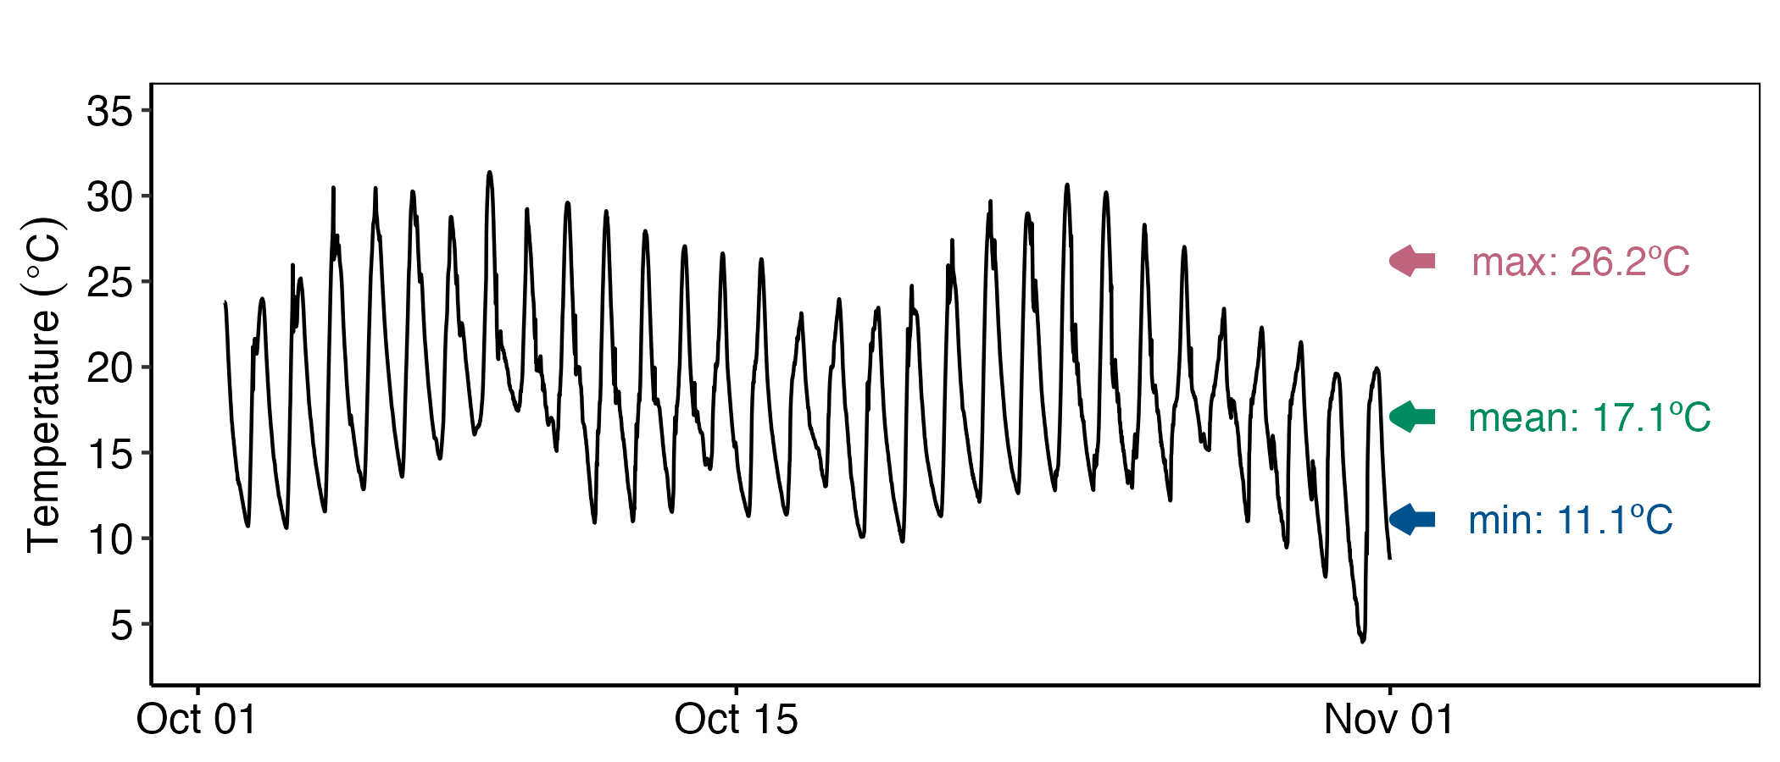
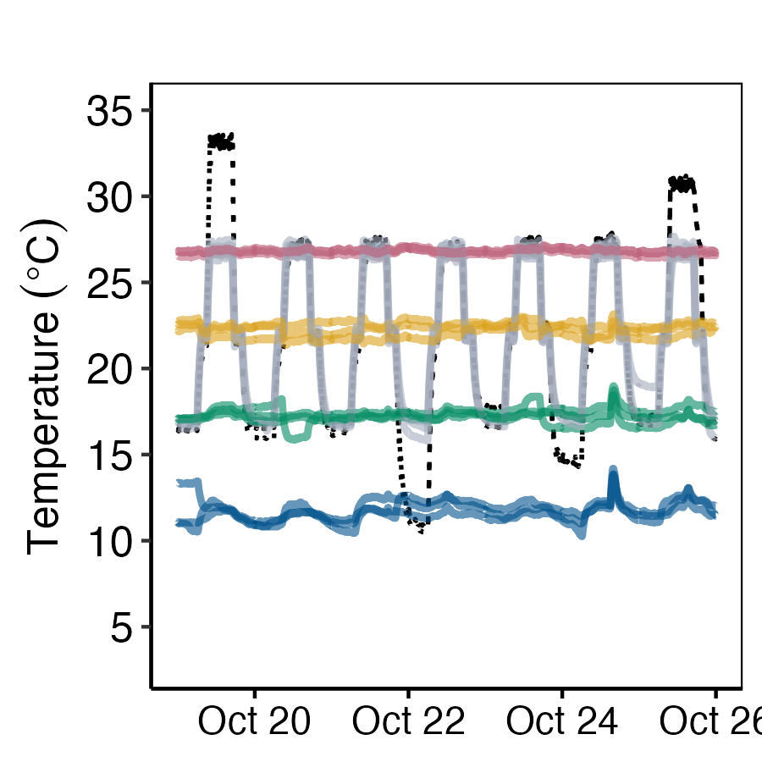

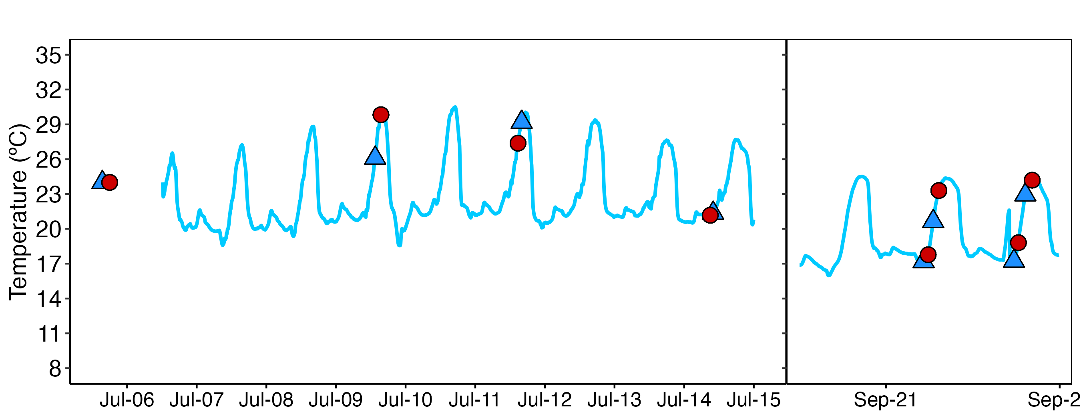
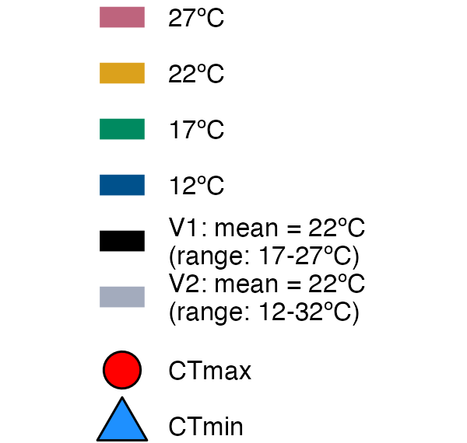
A
site 1
site 2
site 3
field test site
Acclimatization
Site1
Field informed Lab acclimation
B
B
C
C
Acclimatization

Slide 2
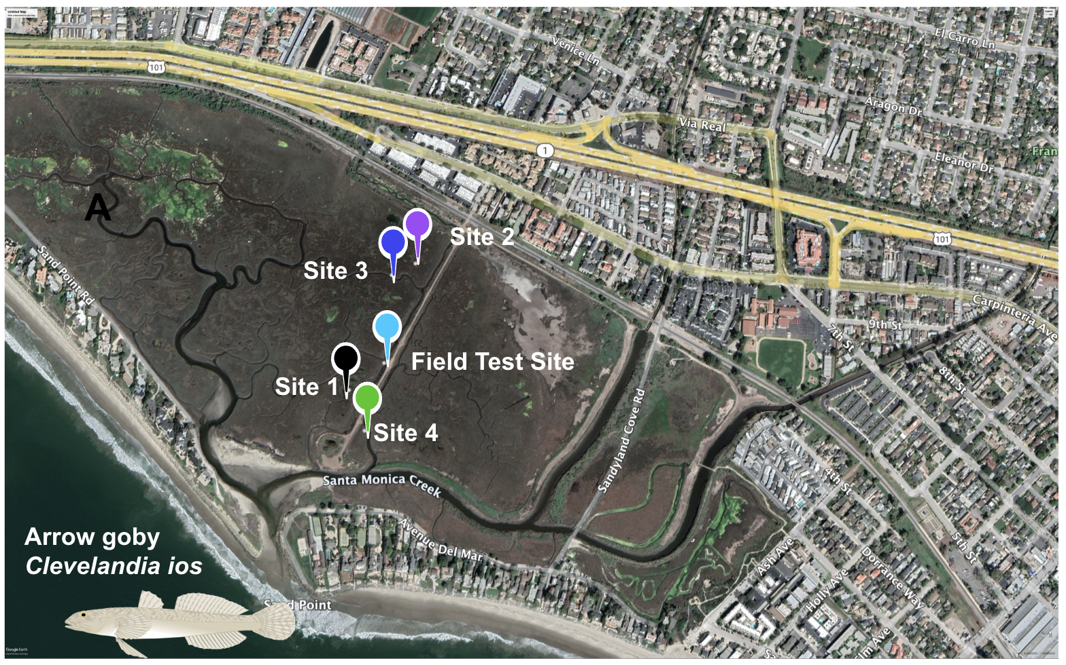
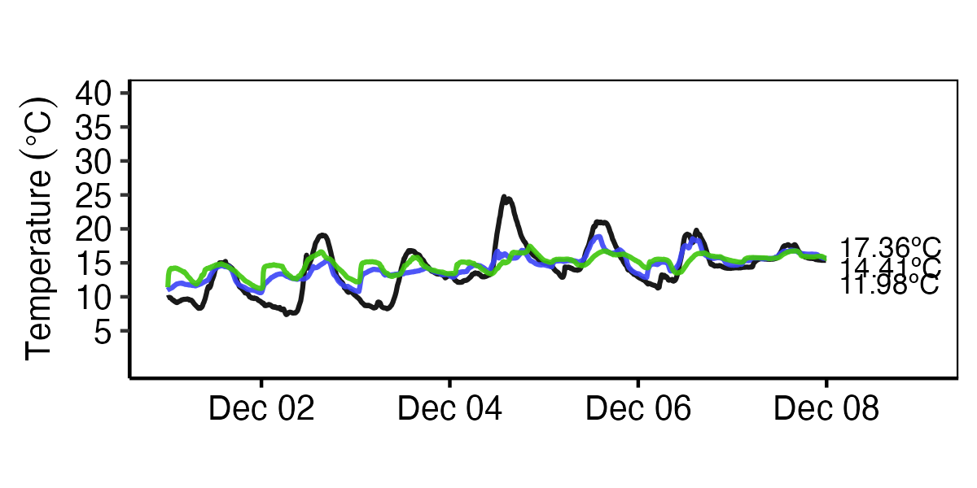
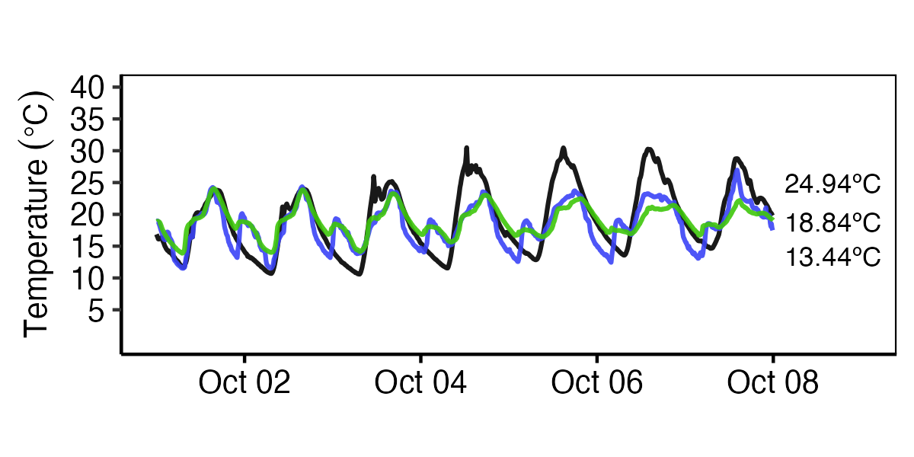
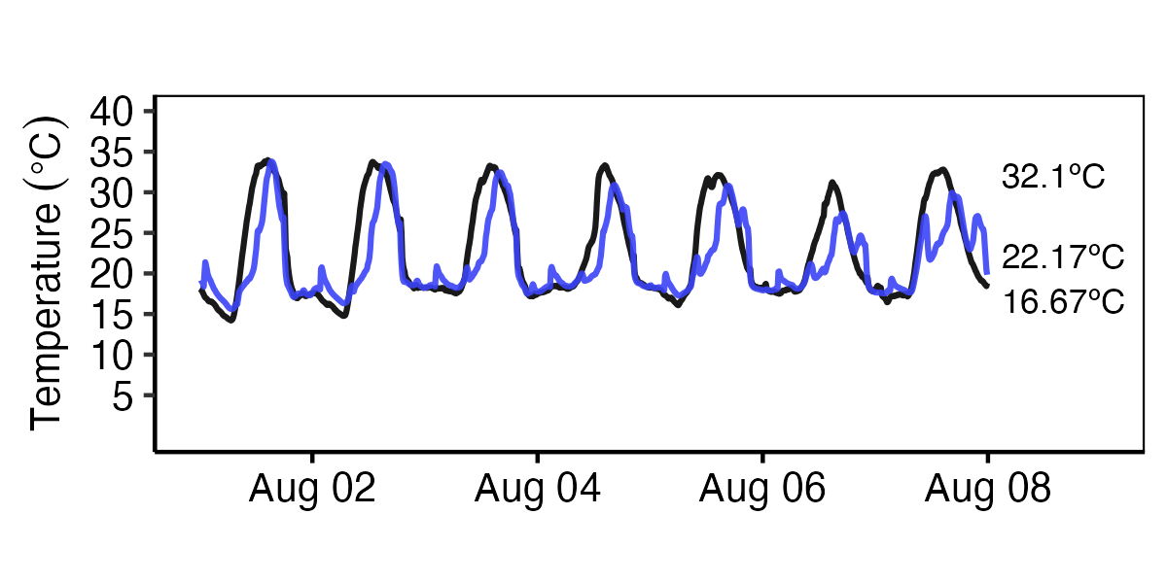
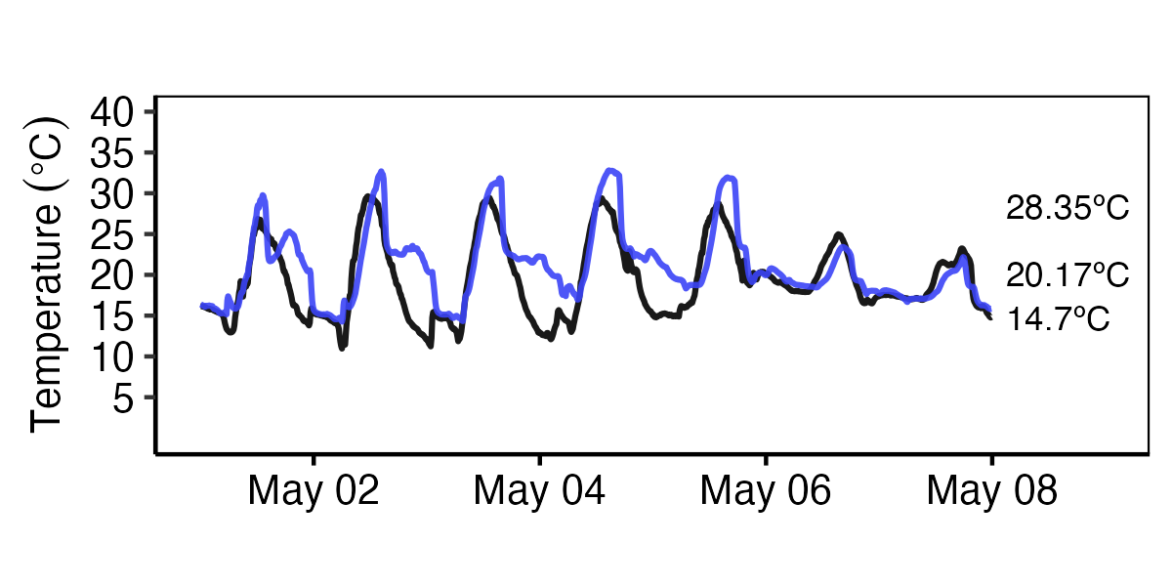
A
B
One - week temperature trends across sites
2019
2019
C
Site | Min (ºC) | Max (ºC) | Mean (ºC) | Range (ºC) | Recording time span (Year-month-day)
# 1 | 11.1 ± 4.7 | 26.1 ± 5.3 | 17.0 ± 4.0 | 15 ± 4.1 | 2019-09-17 to 2021-07-05
# 2 | 15.2 ± 1.5 | 28.6 ± 2.7 | 21.2 ± 1.8 | 13.4 ± 2.5 | 2019-09-17 to 2019-09-26
# 3 | 13.5 ± 3.9 | 24.1 ± 5.7 | 17.8 ± 3.7 | 10.6 ± 4.1 | 2019-09-26 to 2021-07-05
# 4 | 13.3 ± 2.8 | 19.4 ± 3.4 | 16.3 ± 2.6 | 6.0 ± 1.8 | 2019-09-17 to 2020-02-02
Test | 14.6 ± 3.2 | 20.3 ± 4.3 | 17.1 ± 3.2 | 5.7 ± 2.1 | 2021-07-06 to 2022-04-11
2020
2020
2021

Slide 3
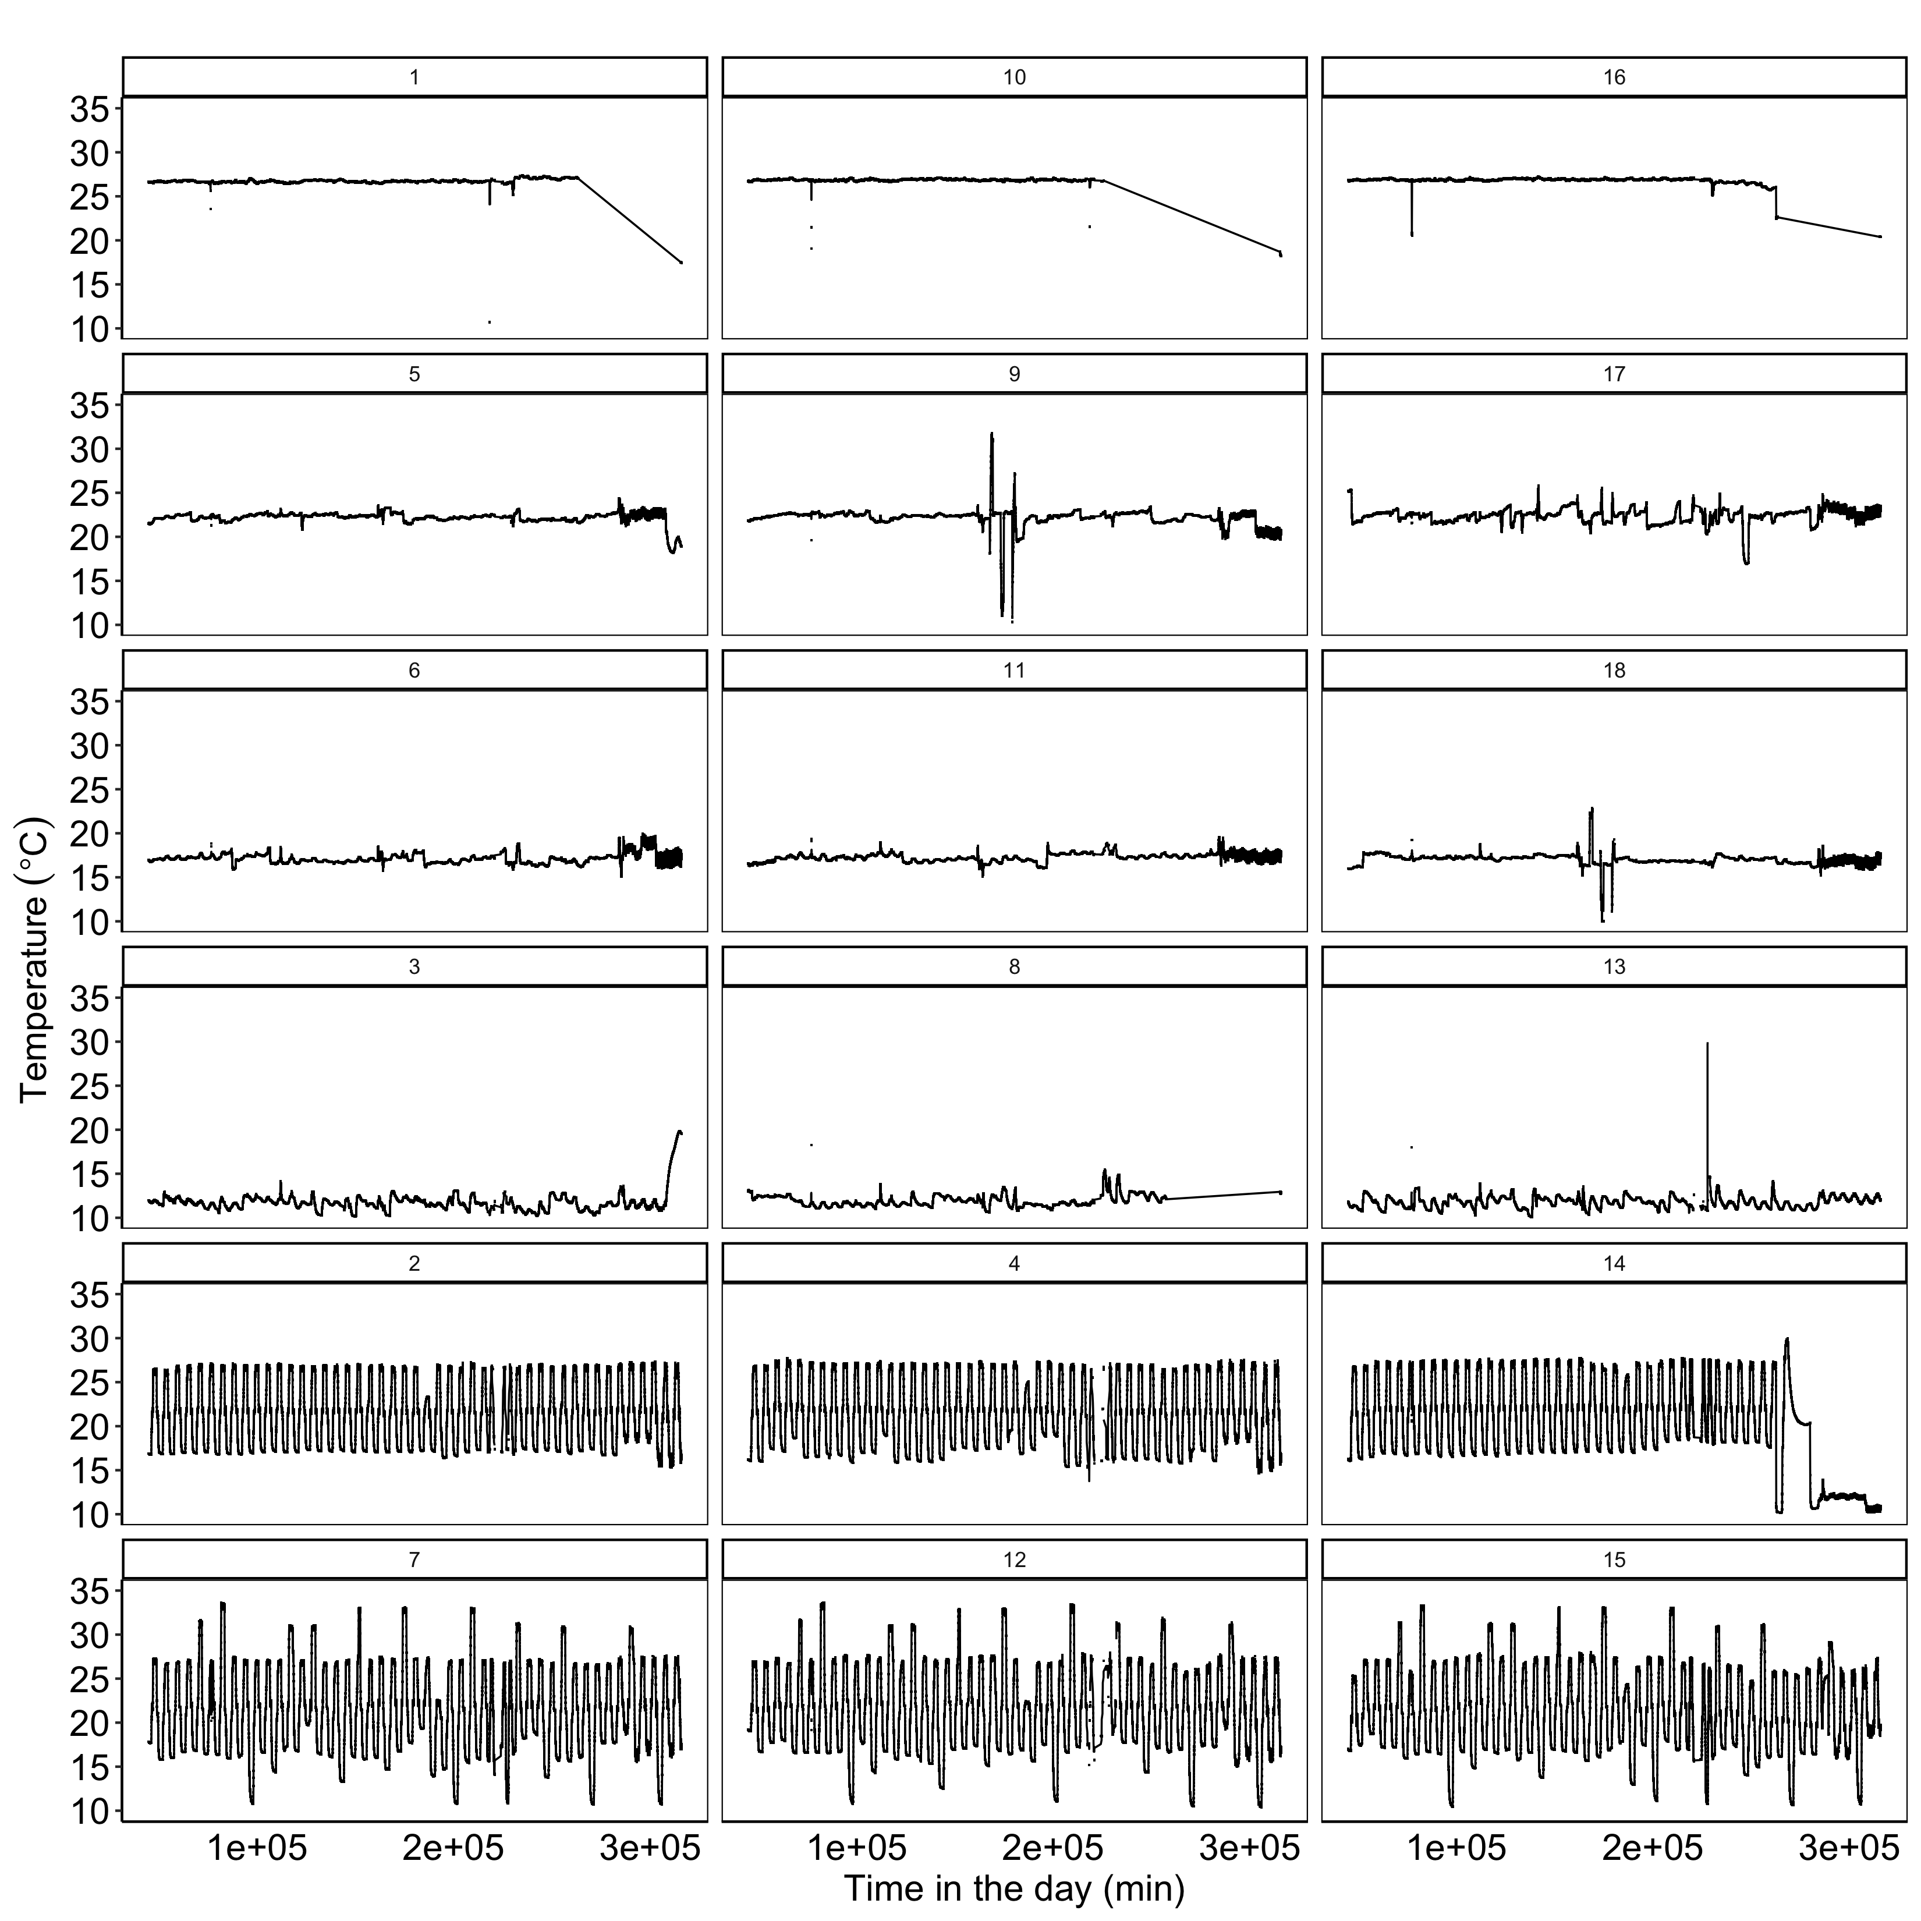
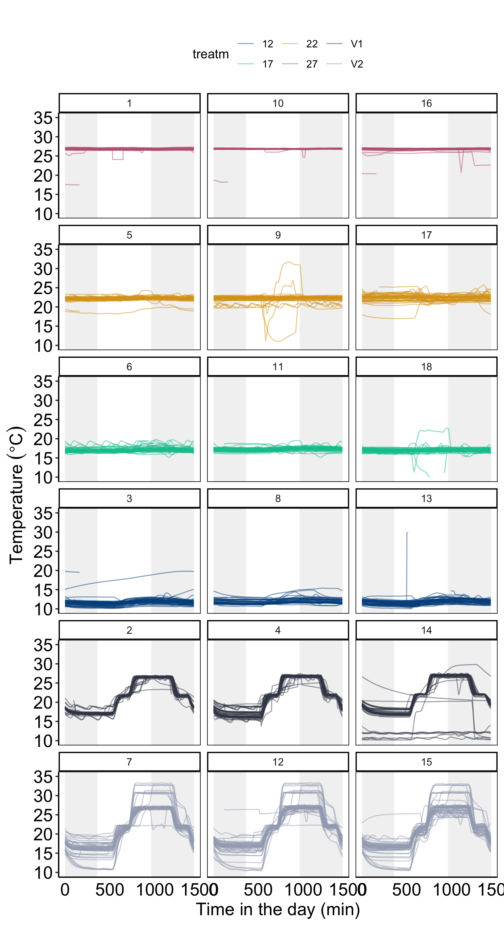
LAB acclimations data full look
HOT 27ºC
WARM 22ºC
MED 17ºC
COLD 12ºC
V1 17-27ºC
V2 17-27ºC**
+ irregular swings

